Slide 1



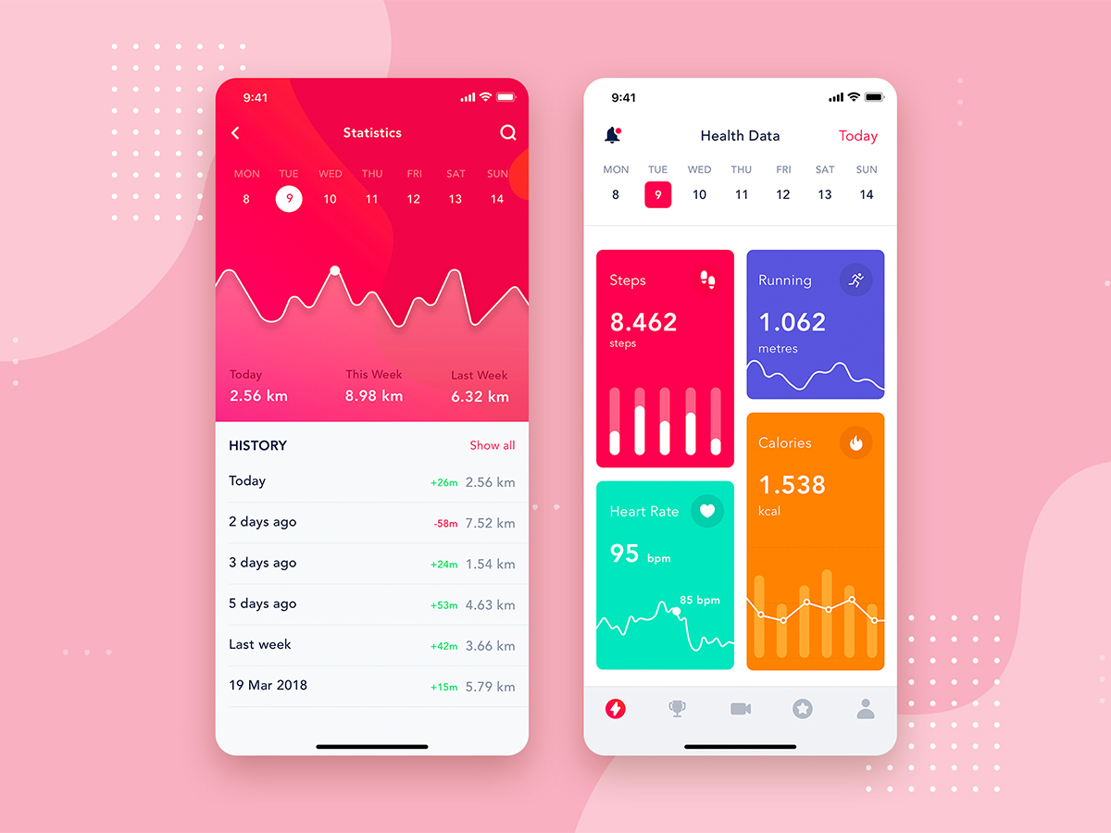
Predictive Modeling and Analytics
Unit 1
Data Preparation

Slide 2
Index
Introduction – Predictive Analytics in the Wild
Exploring Data types and associated Techniques
Complexities of data
Applying Models:
Models and simulation
Categorizing Models
Describing, summarizing data, and decisions
Identify similarities in Data:
Data Clustering
converting Raw Data into a Matrix
Identify K-groups in Data

Slide 3


Slide 5
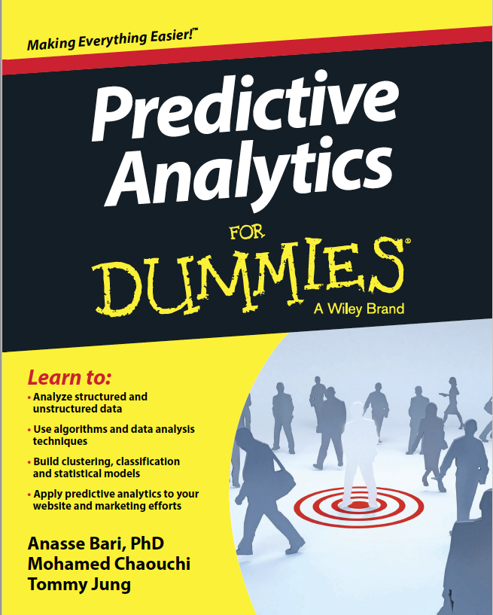
TEXTBOOK

Slide 6
Exploring Predictive Analytics (AIM)
Productive
Efficient
Powerful

Slide 7
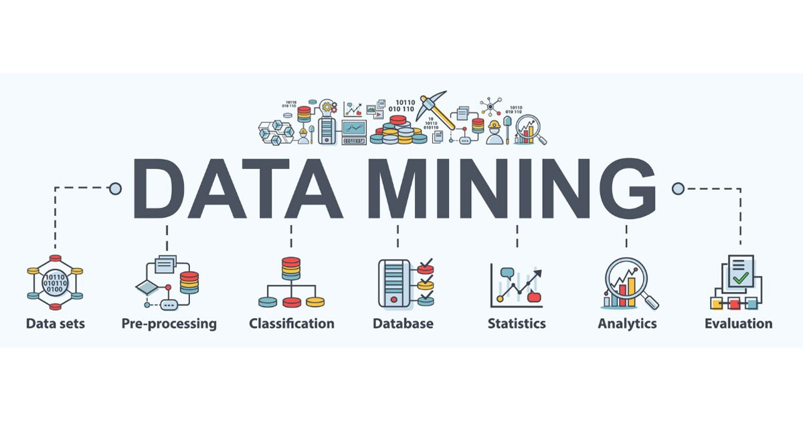
MINING DATA

Slide 8







Into the Digital Era
➢ People’s daily lives
• > 4 billion internet users
• Social media, smart devices, …
➢ Scientific discovery
• Rubin Observatory: 20TB/night
➢ Many application domains…

Slide 9
Digital Era
a lot of digital information.
We are interacting with various types of digital devices.
We are creating a lot of digital content and also many different types of apps, and behind the thing, there's more data involved.
More than four billion Internet users nowadays, and they are a wide variety of social media or smart devices that we interact on a daily basis.
scientific discovery. In those domains, we are seeing increasingly a number of sensing devices and also increasing sensing capabilities.
As a result, We are continuously generating a lot of information for scientific discovery.

Slide 10
Why Data Mining?
Explosive data growth
KB, MB, GB, TB, PB, EB, ZB
Data creation, transmission, storage, sharing, processing
Ø Drowning in data & starving for knowledge
Need automated analysis of massive data
Its a power to identify patterns and relationships in large volumes of data from multiple sources.
Notes:
Think about the size of the data we have been dealing with.
When I started learning computer science, kilobytes was actually sufficient for most of the task.
Then very quickly we moved to the eras of megabytes, gigabytes.
Nowadays, most of you probably have access to some terabytes of hard drives, and we are already actually in the area where many of our application domains are dealing with petabytes of data.

Slide 11
Why Data Mining
We are dealing with a lot of data.
Enabling capabilities -that's the creation of data
we have the capability to collect a lot of data
we have the way to transmit them so it's easy for us to share or access the different types of data.
We have the storage spaces, so we can now handle a lot of digital data, and it's the computation capabilities

Slide 12
What is Data Mining?
Knowledge discovery from data
Extraction of interesting patterns or knowledge from huge amounts of data
Interesting: valid, previously unknown, potentially useful, ultimately understandable by human
Huge amounts of data: scalability, efficiency

Slide 13
Data Mining: Four Views
Application
Knowledge
Technique
Data

Slide 14
Four Views
Arrows really demonstrate how interconnected and also how important it is for you to have this integrated view, because you don't just take one piece and then just focus on that one, you do need to have a reasonably good understanding of all those components and how they come together.

Slide 15
Data View (1)
Value
➢ The 3Vs, 4Vs, 5Vs
Volume
Variety
Velocity
Veracity

Slide 16
1st V is about volume
It is estimated that we create 2.3 trillion gigabytes of data every day. And that will only increase.
This increase is of course partly caused by the gigantic mobile telephone network.
six of the seven billion people in the world now have a mobile phone.
Text and WhatsApp messages, photos, videos and many apps ensure that the amount of data increases significantly.
As the volume grows so rapidly, so does the need for new database management systems and IT employees.

Slide 17
2nd V is about Verity
The high speed and considerable volume are related to the variety of forms of data.
Smart IT solutions are available today for all sectors, from the medical world to construction and business.
Consider, for example, the electronic patient records in healthcare, which contribute to many trillions of gigabytes of data
the videos we watch on Youtube, the posts we share on Facebook and the blog articles we write.

Slide 18
3rd V is Velocity
The third V is about velocity. That'll basically talks about changes or dynamics of your data.
There are traditional or even nowadays in many other scenarios, starting with static data.
That means you just get one copy of your dataset and then you can work with it, but many other times you’re talking about things that change
The velocity really speaks to the point about how quickly data are being generated, but also related to that is about how quickly your analysis needs to be done, how you react to the dynamic data

Slide 19
4th v is about Veracity
This V is about veracity. What it talks about is really the quality of your data. To what extent do you trust your data?
To actually the point your dataset is actually hopefully free of errors, or any potential issues.

Slide 20
That’s how we have 5th V
V really lead to the 5th V. That is about a value.
Whatever you do with the data mining, we want to bring out value from the data.

Slide 21
Data View (2)
Relational, transactional data
E.g., student records, bank accounts, store purchases
Sequential, temporal, streaming data
E.g., gene sequences, stock prices, sensor readings
Spatial, spatial-temporal data
E.g., land use, bird migration, traffic condition

Slide 22
Data View (3)
Text, multimedia, Web data
E.g., news articles, audio/video/image, hypertext
Graph, network data
E.g., social network, power grid, co-authorship
Single or mixture of multiple data types

Slide 23
Textual Data
Textual data is widely used nowadays, and also actually big part of many data mining tasks.
Think about news articles, think about customer reviews, so those could actually be very useful in many scenarios.
Also think about the multimedia data where you could have audio, video, images,
how you can extract information
learn useful patterns where I found those margin media into our data

Slide 24
Application View (1)
Market analysis, target advertisement
E.g., customer profiling, product recommendation
Healthcare, medical research
E.g., disease diagnosis, patient care, drug discovery
Science and engineering
E.g., air pollution, marine life, electric vehicles

Slide 25
Application View (2)
Ø Security
E.g., surveillance, intrusion/crime, fraud, cyberattack
Ø Government, nonprofit
E.g., urban planning, traffic control, education
Ø And many many more …

Slide 26
Knowledge View (1)
Frequent pattern, association, correlation
E.g., songs listened together or in certain sequence
E.g., A is (more/less) likely to happen given B
Categorization
E.g., similarity among users with certain purchases
E.g., differences between two patient groups
Anomaly, outliers
E.g., sensor errors, fraud activities, extreme events
Changes over time
E.g., emerging new patterns, shift of user interest
Descriptive, predictive, prescriptive

Slide 27
Technique View
Frequent pattern analysis
Classification, prediction
Clustering
Anomaly detection
Trend and evolution analysis

Slide 28

MODEL
Albert Einstein-
“Know where to find information and how to use it;
that is the secret of success.”

Slide 29
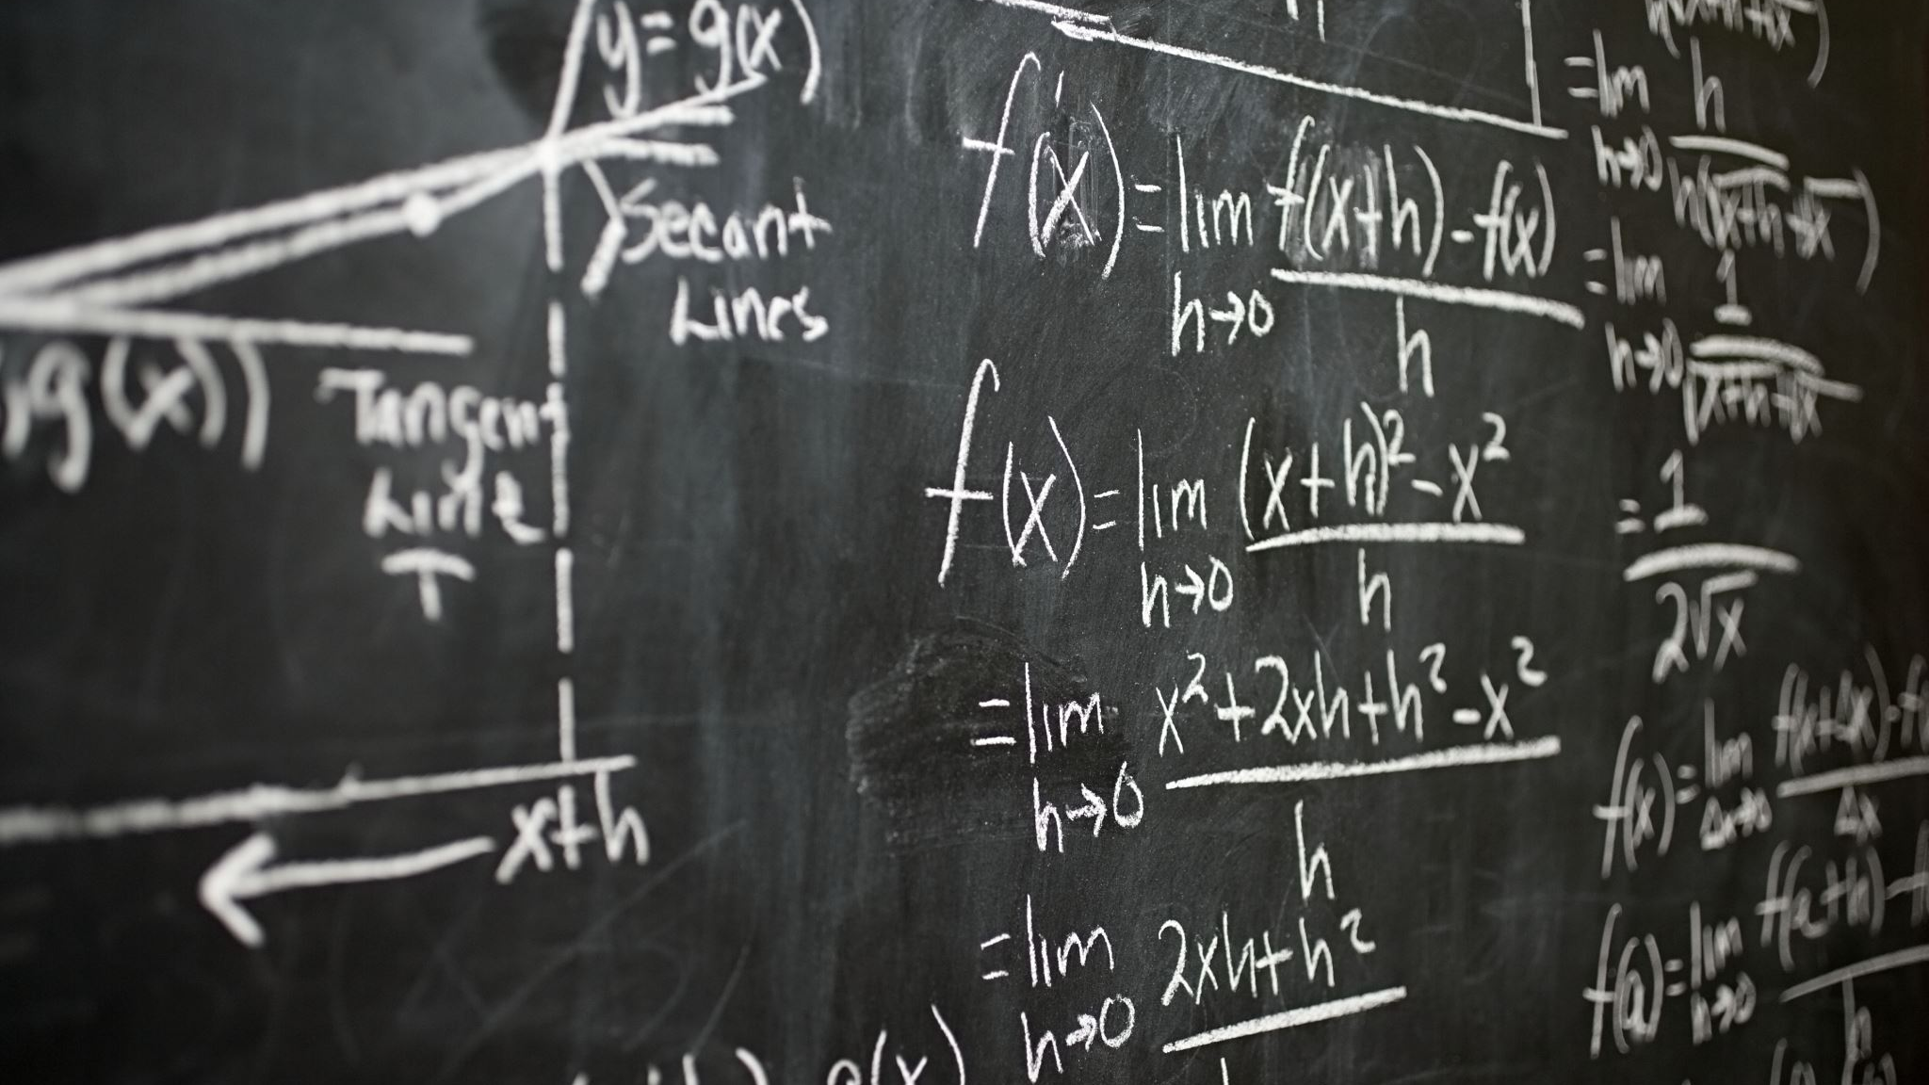
WHAT IS A MODEL ?
A mathematical representation of an object or a process.
to simulate real-world phenomena as a further investigative step, in
hopes of understanding more clearly

Slide 30
For example
Model our customers’ behaviour, we seek to mimic how our customers have
been navigating through our websites:
✓ What products did they look at before they made a purchase?
✓ What pages did they view before making that purchase?
✓ Did they look at the products’ descriptions?
✓ Did they read users’ reviews?
✓ How many reviews did they read?
✓ Did they read both positive and negative reviews?
✓ Did they purchase something else in addition to the product they came
looking for?

Slide 31
developing predictive analytics.
This process is not to be confused with just reporting on the data; it’s also different from just visualizing that data.
Although those steps are vital, they’re just the beginning of exploring the data and gaining a usable understanding of it.

Slide 32
a threefold approach
✓ Thoroughly understand the business problem we’re trying to solve.
✓ Obtain and prepare the data we want our model to work with.
✓ Run statistical analysis, data-mining, and machine-learning algorithms on the data.

Slide 33
Simple rule-based trading model 1:
✓ If it’s past 10:00a.m. ET and the market is up, then buy 100 shares of XYZ stock.
✓ If my stock is up by 10 percent, then take profits.
✓ If my portfolio is down by 10 percent, then exit my positions.

Slide 34
Simple rule-based recommender system
✓ If a person buys a book by this author, then recommend other books by the same author.
✓ If a person buys a book on this topic, then recommend other books on the same and related topic.
✓ If a person buys a book on this topic, then recommend books that other customers have purchased when they bought this book.

Slide 35
Predictive Analytics in the Wild
Identifying some common use cases
Implementing recommender systems
Improving targeted marketing
Using predictive analytics for fraud prevention

Slide 36
Online Marketing and Retail
Companies that have successfully used predictive analytics to improve their sales and marketing include Target Corporation, Amazon, and Netflix.
Recent reports by Gartner, IBM, Sloan, and Accenture all suggest that many executives use data and predictive analytics to drive sales.

Slide 37
Recommender systems
Systems try to predict your interests (for example, what you want to buy or watch) and give you recommendations.
They do this by matching your preferences with items or other like-minded people, using statistics and machine learning algorithms.
If you’re an online cruiser, you often see prompts like these on web pages:
✓ People You May Know . . .
✓ People Who Viewed This Item Also Viewed . . .
✓ People Who Viewed This Item Bought . . .
✓ Recommended Based on Your Browsing History . . .
✓ Customers Who Bought This Item Also Bought . . .

Slide 38
Aim of system
Obviously, these systems were not created only for the user’s convenience — although that reason is definitely one part of the picture.
No, recommender systems were created to maximize company profits.
They attempt to personalize shopping on the Internet, with an algorithm serving as the salesperson.
They were designed to sell, up-sell, cross-sell, keep you engaged, and keep you coming back.
The goal is to turn each personalized shopper into a repeat customer.

Slide 39
Personalize shopping on the Internet
A software recommender system is like an online salesperson who tries to replicate the personal process we experienced at the trade shows.
What’s different about a recommender system is that it’s data-driven.
It makes recommendations in volume, with some subtlety (even stealth), with a dash of unconventional wisdom and without feeling of bias.
When a customer buys a product — or shows interest in a product (say, by viewing it), the system recommends a product or service that it considers highly relevant to that customer — automatically.
The goal is to generate more sales — sales that wouldn’t happen if the recommendation(s) weren’t given.

Slide 40
Amazon: a recommender system
When you browse for an item on the Amazon website, you always find some variation on the theme of related items
— “Customers who viewed this also viewed” or “Customers who bought items in your recent history also bought.”
This highly effective technique is considered one of Amazon’s “killer” features — and a big reason for their huge success as the dominant online marketplace.
Amazon brilliantly adapted a successful offline technique practiced by salespeople — and perfected it for the online world.
Amazon popularized recommender systems for e-commerce.
Their successful example has made recommender systems so popular and important in e-commerce that other companies are following suit.

Slide 41
Implementing a Recommender System
There are three main approaches to creating a recommender system:
collaborative filtering:
The collaborative filtering approach uses the collective actions of the user to achieve the goal of predicting the user’s future behaviour.
content-based filtering:
The content-based approach attempts to match a particular user’s preferences to an item without regard to other users’ opinions.
a combination of both called the hybrid approach:
There are challenges to both the collaborative and content-based filtering approaches, which the hybrid approach attempts to solve.

Slide 42
Collaborative filtering
focuses on user and item characteristics based on the actions of the community.
It can group users with similar interests or tastes, using classification algorithms such as k-nearest neighbour — k-NN for short
It can compute the similarity between items or users, using similarity measures such as cosine
The general concept is to find groups of people who like the same things:
If person A likes X, then person B will also like X. For example: If Tiffany likes watching Toy Story, then her neighbor Victoria will also like watching Toy Story.

Slide 43
Requirement of collaborative filtering
Collaborative filtering algorithms generally require
✓ A community of users to generate data
✓ Creating a database of interests for items by users
✓ Formulas that can compute the similarity between items or users
✓ Algorithms that can match users with similar interests

Slide 44
2 approaches
Item-based collaborative filtering
User-based collaborative filtering

Slide 45
Item-based collaborative filtering
One of Amazon’s recommender systems uses item-based collaborative filtering —
doling out a huge inventory of products from the company database when a user views a single item on the website.
You know you’re looking at an item-based collaborative filtering system (or, often, a content-based system) if it shows you recommendations at your very first item view, even if you haven’t created a profile.
Although your profile hasn’t been created yet (because you aren’t logged in or you don’t have any previous browser history on that site) the system takes what amounts to a guess:
It bases its recommendation on the item itself and what other customers viewed or bought after (or before) they purchased that item.

Slide 46
Item-based collaborative filtering
So you’ll see some onscreen message like
Customers who bought this item also bought . . .
Customers who bought items in your recent history also bought . . .
What other items do customers buy after viewing this item?
In essence, the recommendation is based on how similar the currently viewed item is to other items, based on the actions of the community of users.

Slide 47
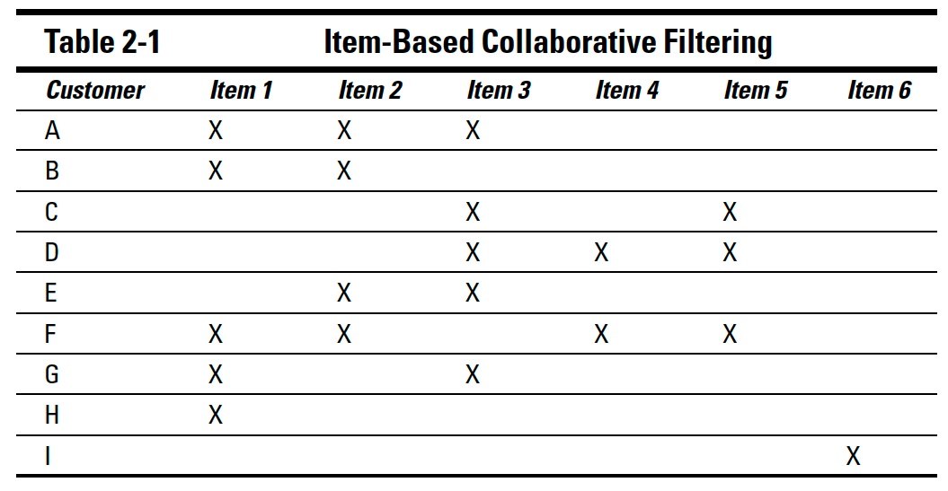
sample matrix of customers and the items they purchased

Slide 48
Item similarity calculated using the cosine similarity formula
The formula for cosine similarity is
(A · B) / (||A|| ||B||)
where, A and B are items to compare.
To read the table and find out how similar a pair of items are, just locate the cell where the two items intersect.
The number will be between 0 and 1.
A value of 1 means the items are perfectly similar; 0 means they are not similar

Slide 49
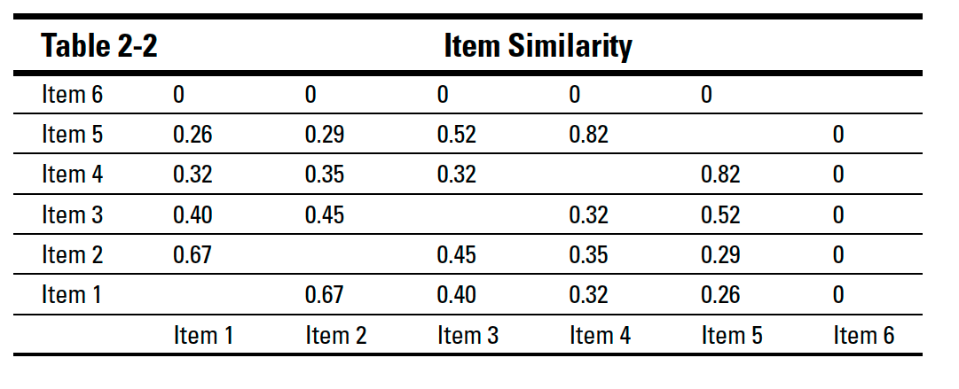
Table similarity calculated using the cosine similarity formula

Slide 50
RECOMMENDATION
The system can provide a list of recommendations that are above a certain similarity value or can recommend the top n number of items.
In this scenario, we can say that any value greater than or equal to 0.40 is similar; the system will recommend those items.
For example, the similarity between item 1 and item 2 is 0.67.
The similarity between item 2 and item 1 is the same. Thus the table is a mirror image across the diagonal from lower-left to upper-right.
You can also see that item 6 is not similar to any other items because it has a value of 0.

Slide 51
Implementation of an item-based recommendation system
use one criterion to determine item similarity: whether the user purchased the item.
More complex systems could go into greater detail by
✓ Using profiles created by users that represent their tastes
✓ Factoring in how much s user likes (or highly rates) an item
✓ Weighing how many items the user purchased that are similar to the potential recommended item(s)
✓ Making assumptions about whether a user likes an item on the basis of whether the user has simply viewed the item, even though no purchase was made

Slide 52
use of recommender system: ✓Offline
via an e-mail marketing campaign or if the user is on the website while logged in
Item 3 to Customer B
Recommended because Customer B purchased Items 1 and 2, and both items are similar to Item 3.
Item 4, then Item 2, to Customer C
Recommended because Customer C purchased Items 3 and 5. Item 5 is similar to Item 4 (similarity value: 0.82). Item 2 is similar to Item 3 (similarity value: 0.45).
Item 2 to Customer D
Recommended because Customer D purchased Items 3, 4, and 5. Item 3 is similar to Item 2.
Item 1 to Customer E
Recommended because Customer E purchased Items 2 and 3, both of which are similar to Item 1.
Item 3 to Customer F
Recommended because Customer F purchased Items 1, 2, 4, and 5. Items 1, 2, and 5 are similar to Item 3.

Slide 53
use of recommender system: ✓Offline
Item 2 to Customer G
Recommended because Customer G purchased Items 1 and 3. They are both similar to Item 2.
Item 2, then Item 3, to Customer H
Recommended because Customer H purchased Item 1. Item 1 is similar to Items 2 and 3.
Undetermined item to Customer A
Ideally, you should have a lot more items and users. And there should be some items that a customer has purchased that are similar to other items that he or she has not yet purchased.
Undetermined item to Customer I
In this case, the data is insufficient to serve as the basis of a recommendation.

Slide 54
use of recommender system: ✓Online
via a page view while the user is not logged in.
Order matters — the recommendations must start from highest similarity.
The system would recommend similar items if the user is viewing one of
its items:
• If Item 1 is being viewed, the system recommends Items 2 and 3.
• If Item 2 is being viewed, the system recommends Items 1 and 3.
• If Item 3 is being viewed, the system recommends Items 5, 2, and 1.
• If Item 4 is being viewed, the system recommends Items 5.
• If Item 5 is being viewed, the system recommends Items 4 and 3.
• If Item 6 is being viewed, there is insufficient data to make a recommendation.
This is an example of the cold-start problem

Slide 55
User-based collaborative filtering
With a user-based approach to collaborative filtering, the system can calculate similarity between pairs of users by using the cosine similarity formula, a technique much like the item-based approach.
Usually such calculations take longer to do, and may need to be computed more often, than those used in the item-based approach.
That’s because
✓ You’d have a lot more users than items (ideally anyway).
✓ You’d expect items to change less frequently than users.
✓ With more users and less change in the items offered, you can use many more attributes than just purchase history when calculating user similarity.

Slide 56
User-based collaborative filtering
A user-based system can also use machine-learning algorithms to group all users who have shown that they have the same tastes.
The system builds neighbourhoods of users who have similar profiles, purchase patterns, or rating patterns.
If a person in a neighbourhood buys and likes an item, the recommender system can recommend that item to everyone else in the neighbourhood.

Slide 57
User-based collaborative filtering
As with item-based collaborative filtering, the user-based approach requires sufficient data on each user to be effective.
Before the system can make recommendations, it must create a user profile — so it also requires that the user create an account and be logged in (or store session information in the browser via cookies) while viewing a website.
Initially the system can ask the user explicitly to create a profile, flesh out the profile by asking questions, and then optimize its suggestions after the user’s purchase data has accumulated

Slide 58
Netflix
Netflix is an example of quickly building a profile for each customer. Here’s
the general procedure:
1. Netflix invites its customers to set up queues of the movies they’d like to watch.
2. The chosen movies are analyzed to learn about the customer’s tastes in movies.
3. The predictive model recommends more movies for the customer to watch, based on the movies already in the queue.
Netflix has discovered that the more movies you have in your queue, the more
likely you are to stay a customer.

Slide 59
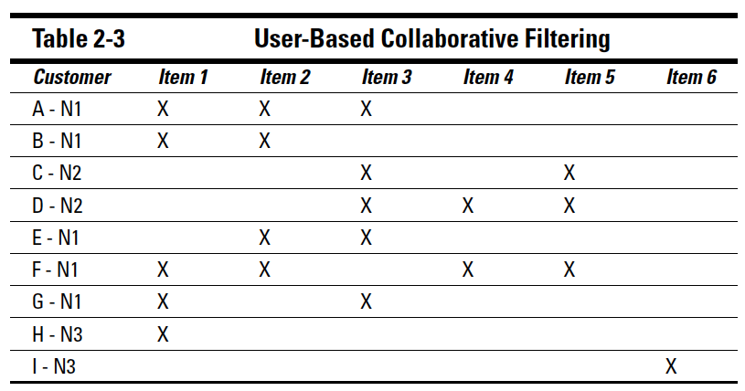
sample matrix of customers and their purchased items

Slide 60
User-based versus item-based collaborative filtering
item-based collaborative filtering for large-scale e-commerce systems is faster and more scalable.
Finding similar users, however — especially users with lots of features — takes longer than finding similar items.
Building user neighbourhoods may be too time-consuming for large datasets, and may not be appropriate for large e-commerce sites that depend on Realtime recommendations.
The user-based system also suffers more acutely than the item-based system from two other challenges: the cold-start problem (mentioned earlier) and sparsity — essentially the fact that even the most prolific customers can’t be expected to purchase even a fraction of a percent of the whole product catalogue.

Slide 61
User-based versus item-based collaborative filtering
So building user neighbourhoods based on limited purchase histories may not produce very accurate recommendations.
The user-based approach also comes with a key restriction: Each user has to be logged in (or have a profile in his or her browser history) for user-based filtering to work.
Before the system can make a recommendation, it has to know something about the prospective customer.

Slide 62
Content-based filtering
Content-based recommender systems mostly match features (tagged keywords) among similar items and the user’s profile to make recommendations.
When a user purchases an item that has tagged features, items with features that match those of the original item will be recommended.
The more features match, the higher the probability the user will like the recommendation.
This degree of probability is called precision.
Content-based filtering uses various techniques to match the attributes of a particular item with a user’s profile.

Slide 63
Content-based filtering
These techniques include machine learning algorithms to determine a user’s profile without having to ask.
This technique is called implicit data gathering.
A more direct approach is to use explicit data gathering: Use a questionnaire to ask the users what features
they like in an item.
An example of that would be asking what genre of movie or which actresses they like when they first sign up for a movie subscription.

Slide 64
Tagging to describe items
the company doing the selling (or the manufacturer) usually tags its items with keywords.
In the Amazon website, however, it’s fairly typical never to see the tags for any items purchased or viewed — and not even to be asked to tag an item.
Customers can review the items they’ve purchased, but that’s not the same as tagging

Slide 65
Issues with User-based tagging
✓ Credibility:
Not all customers tell the truth (especially online), and users who have only a small rating history can skew the data.
some vendors may give (or encourage others to give) positive ratings to their own products while giving negative ratings to their competitors’ products.
✓ Sparsity:
Not all items will be rated or will have enough ratings to produce useful data.
✓ Inconsistency:
Not all users use the same keywords to tag an item, even though the meaning may be the same. Additionally, some attributes can be subjective.
For example, one viewer of a movie may consider it short while another says it’s too long.

Slide 66
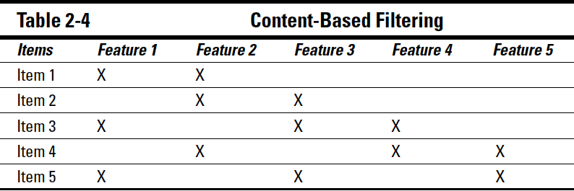
sample matrix of customers and their purchased items

Slide 67
Improving precision with constant feedback
One way to improve the precision of the system’s recommendations is to ask customers for feedback whenever possible.
Collecting customer feedback can be done in many ways, through multiple channels.
Some companies ask the customer to rate an item or service after purchase.
Other systems provide social-media-style links so customers can “like” or “dislike” a product.
Constant interaction between customers and companies may make the customer feel more fully engaged.

Slide 68
Improving precision with constant feedback
For instance, Netflix asks its customers to rate movies they’ve watched so that the company can use that data to train their systems (models) to makemore precise movie recommendations.
Amazon sends you an e-mail asking you to rate items you’ve purchased after you’ve had enough time to evaluate the product and the buying experience.
Such data points constantly improve the recommendation models — and they’re possible because Amazon and Netflix make a point of convincing customers that their feedback benefits all customers.
Such continuous interaction with customers to collect feedback not only increases the precision of the system’s recommendations
This is a type of cycle that results in more product sales that generate more revenue for the company

Slide 69
Measuring the effectiveness of system recommendations
The success of a system’s recommendations depends on how well it meets two criteria:
Precision (think of it as a set of perfect matches — usually a small set)
Recall (think of it as a set of possible matches — usually a larger set).

Slide 70
Measuring the effectiveness of system recommendations
✓ Precision
Measures how accurate the system’s recommendation was.
Precision is difficult to measure because it can be subjective and hard to quantify.
For instance, when a user first visits the Amazon site, can Amazon know for sure whether its recommendations are on target? Some recommendations may connect with the customer’s interests but the customer may still not buy.
The highest confidence that a recommendation is precise comes from clear evidence: The customer buys the item.
Alternatively, the system can explicitly ask the user to rate its recommendations.
✓ Recall
Measures the set of possible good recommendations your system comes up with.
Think of recall as an inventory of possible recommendations, but not all of them are perfect recommendations. There

Slide 71
Precision versus recall
Recall goes up, precision goes down, and vice versa.
The ideal system would have both high precision and high recall.
the best outcome is to strike a delicate balance between the two.
You can’t expect to have a large inventory of items that a customer will buy.
You may expect to have a large inventory of items that a customer might consider buying.

Slide 72
Hybrid recommender systems
The best implementation may be a hybrid approach to creating a recommender system.
By combining content-based and collaborative filtering into a single approach, the system can try to overcome each one’s shortcomings.
A major problem with the content-based approach is its accuracy and narrow focus.
The recommendations may not be very interesting or unique.
Many of the recommendations may have already been known to the user, so the system isn’t providing anything new from the user’s perspective.
However, the implementation is much simpler than that of collaborative filtering.
The content-based approach requires only that a profile be created for the items (keyword tagging).
The user’s profile can be implicitly or explicitly created.

Slide 73
Hybrid recommender systems
A major problem with collaborative filtering is that it suffers from the coldstart problem.
Many users who are just starting out won’t receive accurate recommendations — or any recommendations at all — until enough data is gathered from the community of users.
The data collection will require time to complete — and that collection depends on how active the website is.
It may also require users to create accounts in their systems (in order to create a profile) before they can start receiving recommendations.

Slide 74
Solution by Hybrid system
A hybrid recommender system can try to solve both these problems.
It can start by using the content-based approach to avoid the cold-start problem.
Once enough data is collected from the community of users, the system can then use the collaborative filtering approach to produce more interesting and personalized recommendations.

Slide 75

Exploring Your Data Types and Associated Techniques
Unit 1

Slide 76
Goal
Understanding your data, its types, and its categories
Capturing the driving forces
Connecting predictive analytics to statistics, data mining, and machine learning

Slide 77
There are two ways to implement predictive analytics:
✓ Data-driven: This approach is based solely on your data.
✓ User-driven: This approach explores ideas you have — say, for example, about your customers and their behaviour — and examines whether your data supports those ideas.

Slide 78
Types of data
Structured and unstructured data
Static and streamed data

Slide 79
Structured data
Structured data is well organized, follows a consistent order, is relatively easy to search and query, and can be readily accessed and understood by a person or a computer program.
A classic example of structured data is an Excel spreadsheet with labelled columns.
Such structured data is consistent; column headers— usually brief, accurate descriptions of the content in each column — tell you exactly what kind of content to expect.
In a column labeled e-mail address, for example, you can count on finding a list of (no surprise here) e-mail addresses.
Such overt consistency makes structured data amenable to automated data management.

Slide 80
Unstructured data
Unstructured data, on the other hand, tends to be free-form, non- tabular, dispersed, and not easily retrievable; such data requires deliberate intervention to make sense of it.
Miscellaneous e-mails, documents, web pages, and files (whether text, audio, and/or video) in scattered locations are examples of unstructured data.
It’s hard to categorize the content of unstructured data.
It tends to be mostly text, it’s usually created in a hodgepodge of free-form styles, and finding any attributes you can use to describe or group it is no small task.

Slide 81
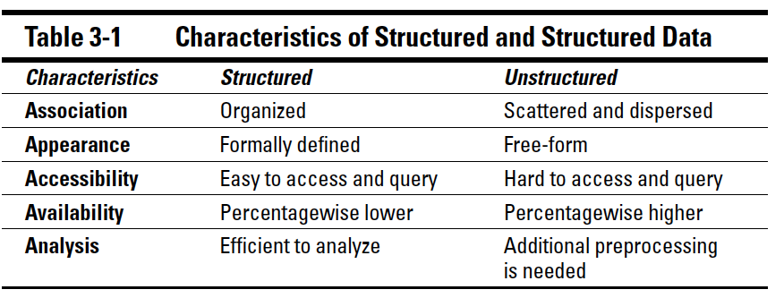

Slide 82
Static and streamed data
Data can also be identified as streamed, static, or a mix of the two.
Streamed data changes continuously; examples include the constant stream of
Facebook updates, tweets on Twitter, and the constantly changing stock prices while the market is still open.
Streamed data is continuously changing; static data is self-contained and enclosed.
The problems associated with static data include gaps, outliers, or incorrect data, all of which may require some cleansing, preparation, and pre-processing before you can use static data for an analysis.

Slide 83
The two main models for analysing streamed data are as follows:
Examine only the newest data points and make a decision about the state of the model and its next move.
This approach is incremental — essentially building up a picture of the data as it arrives.
Evaluate the entire dataset, or a subset of it, to make a decision each time new data points arrive.
This approach is inclusive of more data points in the analysis — what constitutes the “entire” dataset changes every time new data is added.

Slide 84
Identifying Data Categories
Behavioural data
Items bought
Methods of payment
Whether the purchased items were on sale
The purchasers’ access information
Address
Phone number
E-mail address
All of us have provided such data when making a purchase online (or even when buying at a store or over the phone).
Other types of data can be collected from customers with their co-operation:
Data provided by customers when they fill out surveys
Customers’ collected answers to polls via questionnaire
Information collected from customers who make direct contact with companies
In a physical store
Over the phone
Through the company website

Slide 85
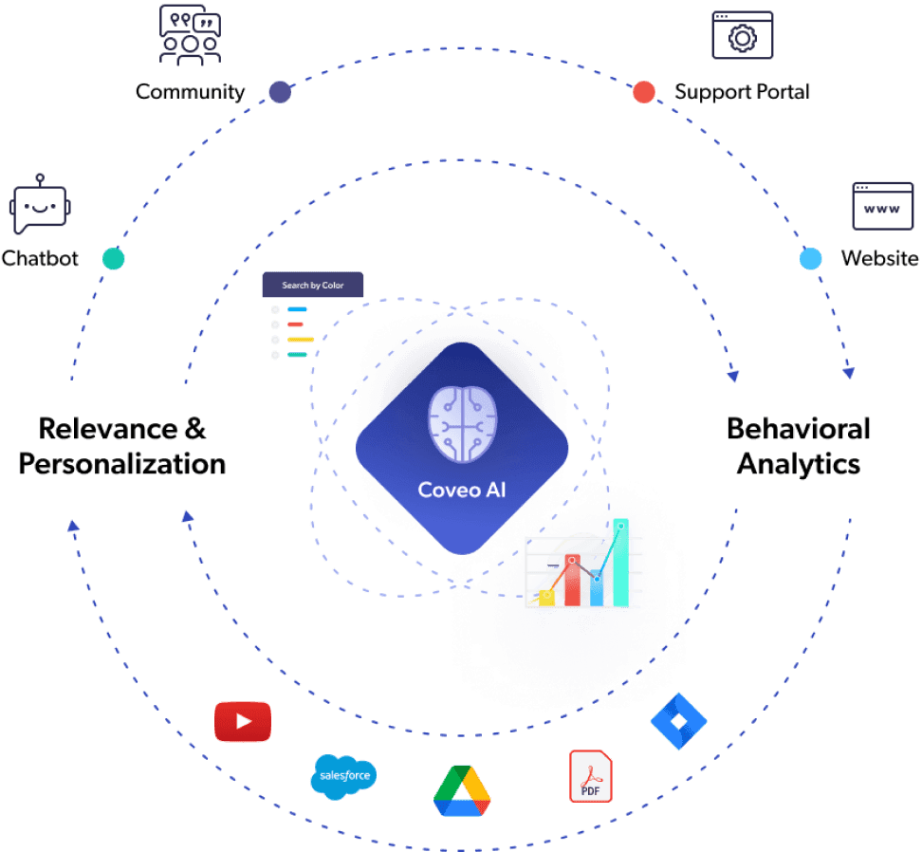

Slide 86
Attitudinal data
Any information that can shed light on how customers think, or feel is considered attitudinal data.
When companies put out surveys that ask their customers for feedback and their thoughts about their line of businesses and products, the collected data is an example of attitudinal data.
Attitudinal data has a direct impact on the type of marketing campaign a company can launch. It helps shape and target the message of that campaign.
Attitudinal data can help make both the message and the products more relevant to the customers’ needs and wants —allowing the business to serve existing customers better and attract prospective ones.
The limitation of attitudinal data is a certain imperfection: Not everyone objectively answers survey questions, and not everyone provides all the relevant details that shaped their thinking at the time of the survey.

Slide 87
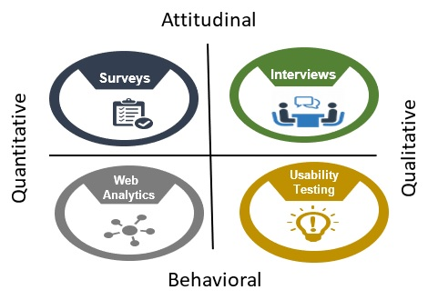

Slide 88
Behavioural data
Behavioural data derives from what customers do when they interact with the business; it consists mainly of data from sales transactions.
Behavioural data tends to be more reliable than attitudinal data because it represents what happened.
Businesses know, for example, what products are selling, who is buying them, and how customers are paying for them.
Behavioural data is a by-product of normal operations, so is available to a company at no extra cost. Attitudinal data, on the other hand, requires conducting surveys or commissioning market research to get insights into the minds of the customers.

Slide 89
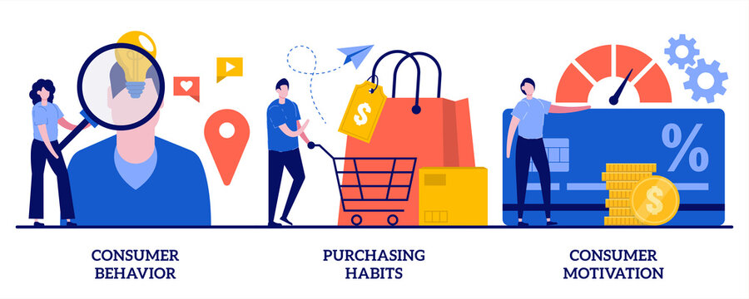

Slide 90
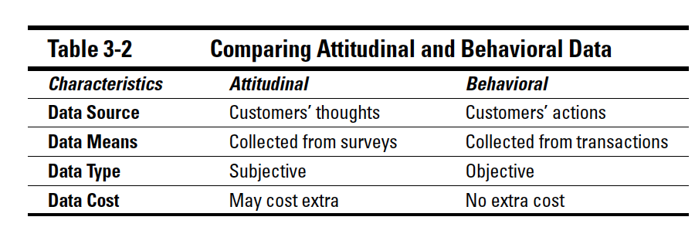

Slide 91
Demographic data
Demographic data comprises information including age, race, marital status, education level, employment status, household income, and location.
You can get demographic data from the U.S. Census Bureau, other government agencies, or through commercial entities.
The more data you have about your customers, the better the insight you’ll have into identifying specific demographic and market trends as well as how they may affect your business.
Measuring the pulse of the demographic trends will enable you to adjust to the changes and better market to, attract, and serve those segments.

Slide 92
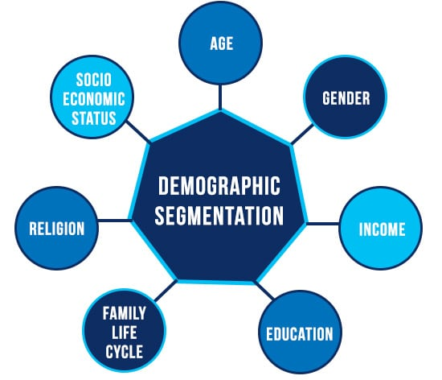

Slide 93
Demographic data
Different segments of the population are interested in different products.
Small businesses catering to specific locations should pay attention to the demographic changes in those locations.
All of us have witnessed populations changing over time in certain neighbourhoods. Businesses must be aware of such changes; they may affect business significantly.
Demographic data, when combined with behavioural and attitudinal data, allows marketers to paint an accurate picture of their current and potential customers, allowing them to increase satisfaction, retention, and acquisition.

Slide 94

Generating Predictive Analytics

Slide 95
Predictive analytics
There are two ways to go about generating or implementing predictive analytics:
Purely based on your data (with no prior knowledge of what you’re after) or with a proposed business goal that the data may or may not support.
To decide whether to act on what you find.
Combining both types of analysis empowers your business and enables you to expand your understanding, insight, and awareness of your business and your customers.
It makes your decision process smarter and subsequently more profitable.

Slide 96
Data-driven analytics
If you’re basing your analysis purely on existing data, you can use internal data — accumulated by your company over the years — or external data (often purchased from a source outside your company) that is relevant to your line of business.
employ data-mining tools to overcome both its complexity and size; reveal some patterns you were not aware of; uncover some associations and links within your data; and use your findings to generate new categorizations, new insights and new understanding.
Data- driven analysis can even reveal a gem or two that can radically improve your business — all of which gives this approach an element of surprise that feeds on curiosity and builds anticipation.

Slide 97
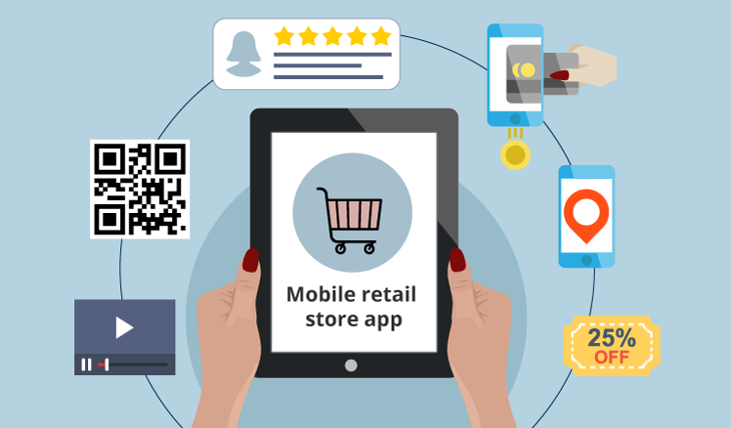
Data-driven analytics
Data-driven analysis is best suited for large datasets because it’s hard for human beings to wrap their minds around huge amounts of data.
Data- mining tools and visualization techniques help us get a closer look and cut the overwhelming mass of data down to size.

Slide 98
General principles
The more complete your data is, the better the outcome of data-driven analytics.
Data-driven analytics is neutral because no prior knowledge about the data is necessary and you’re not after a specific goal but analysing the data for the sake of it.
The nature of this analysis is broad and it does not concern itself with a specific search or validation of a preconceived idea.
whether the results you’re getting are worth implementing or acting upon.
Notes:
If you have extensive data that has key information to the variables you’re measuring, and spans an extended period of time, you’re guaranteed to discover something new about your business.
This approach to analytics can be viewed as sort of random and broad data mining.
If you conduct such data analysis, and if you learn something about your business from the analysis, you’ll still need to decide

Slide 99
General principles
Relying solely on data-driven analytics adds some risk to the resulting business decisions.
When real-world data proves (or at least supports) the correctness of your original ideas, then the appropriate decision is practically already made.
When an informed hunch is validated by the data, the whole analysis shows itself as driven by strategic ideas that were worth pursuing and verifying.
Notes:
1. You can, however, limit that risk by incorporating some of the realism that characterizes user-driven analytics (described in the next section).

Slide 100

User-driven analytics
The user-driven approach to predictive analytics starts with ideas and See whether those ideas have merit, would stand testing, and are supported by the data.
The test data can be a very small subset of your total business data; it’s something you define and choose as you deem relevant for testing your ideas.
The process of picking the right datasets and designing accurate testing methods has to be guided by careful consideration and meticulous planning.

Slide 101
User-driven analytics
User-driven analytics requires not only strategic thinking but also enough in- depth knowledge of the business domain to back up the strategizing.
Vision and intuition can be very helpful here; you’re looking for how the data lends specific support to ideas you deemed important and strategic.
This approach to predictive analytics is defined (and limited) by the scope of the ideas you’re probing.
Decision-making becomes easier when the data supports your ideas.

Slide 102
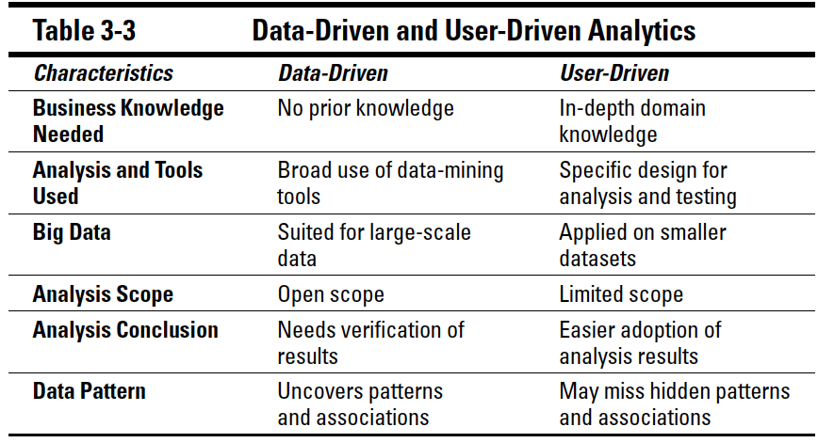

Slide 103
Connecting to Related Disciplines
Statistics
Data mining
Machine learning

Slide 104
Statistics
Statistics are numbers that result from measuring empirical data over time. gathering and analysing data
Statistics can infer relationships within data; thus it plays an active role in presenting data and helping us understand it.
Thus, the discipline is both descriptive and inferential.
Inferential statistics is concerned with making inferences or predictions about the characteristics of a whole population from a sample dataset.
Sample data for analysis is chosen at random, in a way that represents (but does not include) the whole population.
Well-chosen data set findings of the analysis onto the whole population with a realistic degree of accuracy.
Statistics relies, on mathematics to analyze the data by verifying a hypothesis or theory, determining its accuracy, and drawing a conclusion.

Slide 105
Data mining
Data mining is concerned mainly with analyzing data through describing, summarizing, classifying, and clustering the data so as to find useful patterns, links, or associations within it.
Data mining is often used interchangeably with machine learning but there are some distinctions between the two terms.
For example: data miners are familiar with the use of machine learning to perform some tasks involving large amounts of data.
However, they can also create a sophisticated and optimized query on a database without the use of machine learning— which would still be considered data mining.

Slide 106
Machine learning
Machine learning is another discipline that focuses on analyzing the data and making sense of it — but does so by teaching a computer program to do the work.
The more data is analysed, the more the system can learn about it, what to expect from it, and what to do with it.
When a new special case, usually an exception or a new behavior, is processed for the first time, the knowledge base of the system is incremented to include the new case.
The more special cases are handled, the better equipped the system is to make decisions that produce the most useful outcome.
This is the nature of the learning that the machine is programmed to do.
Machine learning is the equivalent of teaching a system the rules of a game, and then getting the system to practice the game by playing at elementary and intermediate levels.
Machine learning is perfectly suited for
Complex data
Data in various forms
Data collected from diverse sources
Data in large amounts

Slide 107
Complexities of Data

Slide 108
Goal
Meeting the challenges of big data
Making your data semantically retrievable
Distinguishing between business intelligence and data analytics
Using visualizations to guide the cleaning of data

Slide 109
MEETING BIGDATA CHALLENGES
Finding Value in Your Data
1
Delving into your data
Data validity
Data variety
Constantly Changing Data
2
Data velocity
High volume of data
Complexities in Searching Your Data
3
Keyword-based search
Semantic-based search

Slide 110
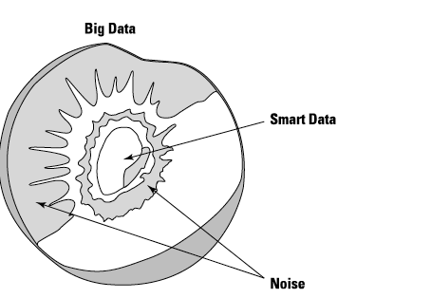
Delving into your data
Using a fruit analogy
you not only have to remove the bad peel or the cover, but dig into it to get to the nucleus
As you get closer to the nucleus, you get to the best part of the fruit.
The same rule applies to big data

Slide 111
Data validity
Most data is either incomplete (missing some attributes or values) or noisy (containing outliers or errors).
In the biomedical bioinformatics fields, for example, outliers can lead the analytics to generate incorrect or misleading results.
Outliers in cancer data, for example, can be a major factor that skews the accuracy of medical treatments:
Gene-expression samples may appear as false cancer positives because they were analysed against a sample that contained errors.
Inconsistent data is data that contains discrepancies in data attributes.
For example, a data record may have two attributes that don’t match: say, a zip code (such as 20037) and a corresponding state (Delaware).
Invalid data can lead to wrong predictive modelling, which leads to misleading analytical results that will cause bad executive decisions.
For instance, sending coupons for diapers to people who have no children is an obvious mistake. But it can happen easily if the marketing department of a diaper company ends up with invalid results from their predictive analytics model.
Notes:
In such cases, it’s possible that there’s too large a margin of error in the models or algorithms.
In most cases, the flaws and anomalies are in the data initially selected to power the predictive model — but the algorithms that power the predictive model might have large chunks of invalid data.

Slide 112
Issues in Real-world Data
Incomplete
Missing values, missing attributes
Noisy
Imprecision, errors, outliers: e.g., age = “-10”
Inconsistent
E.g., age vs. birthday, rating scale

Slide 113
Causes of Data Issues
Data collection/transmission/processing
Human, hardware, and software
Limitations, errors, multiple sources
Changes over time
Updated survey, new sensing capabilities

Slide 114
Data Cleaning
Data in the Real World Is Dirty:
Lots of potentially incorrect data, e.g., instrument faulty, human or computer error, transmission error
Incomplete: lacking attribute values, lacking certain attributes of interest, or containing only aggregate data
e.g., Occupation=“ ” (missing data)
Noisy: containing noise, errors, or outliers
e.g., Salary=“−10” (an error)
Inconsistent: containing discrepancies in codes or names, e.g.,
Age=“42”, Birthday=“03/07/2010”
Was rating “1, 2, 3”, now rating “A, B, C”
discrepancy between duplicate records
Intentional (e.g., disguised missing data)
Jan. 1 as everyone’s birthday?

Slide 115
Data variety
The absence of uniformity in data
From the endless stream of unstructured text data (generated through e-mails, presentations, project reports, texts, tweets) to structured bank statements, geolocation data, and customer demographics,.
Aggregating this data and preparing it for analytics is a complex task.
How can you integrate data generated from different systems such as Twitter, Opentable.com, Google search, and a third party that tracks customer data?
Every situation is different, and the data scientist usually has to do a lot of manoeuvring to integrate the data and prepare it for analytics.
Even so, a simple approach to standardization can support data integration from different sources:
You agree with your data providers to a standard data format that your system can handle
a framework that can make all your data sources generate data that’s readable by both humans and machines.
Think of it as a new language that all big-data sources will speak every time they’re in the big-data world.

Slide 116
Constantly Changing Data
two main challenges of big data:
These are (respectively) the rate at which data is being generated, received, and analyzed, and the growing mass of data.
Data velocity
High volume data

Slide 117
Data velocity
Velocity is the speed of an object moving in a specific direction.
The rate at which data is being generated, captured, or delivered.
Think of the data being generated by a cellphone provider.
This data is growing all the time, making the task of capturing smart data from big data even more challenging.
To address
How often you can capture data
What you can afford in terms of both resources and finances
It includes all customers’ cellphone numbers, call durations, and GPS locations (for openers).
Notes:
If (for example) you own a supercomputer and you have the funds, then you should capture as much data as you can — but you might also need to take into consideration how often that data is changing.

Slide 118
High volume of data
Big data is not just about large volumes of data;
a wide variety of data generated at high speed and frequency.
In Figure , big data spans three dimensions in spiral exponential fashion
Big data is “big” not only because of its large volume;
it’s also about those other three dimensions:
Volume,
Velocity
Variety.

Slide 119
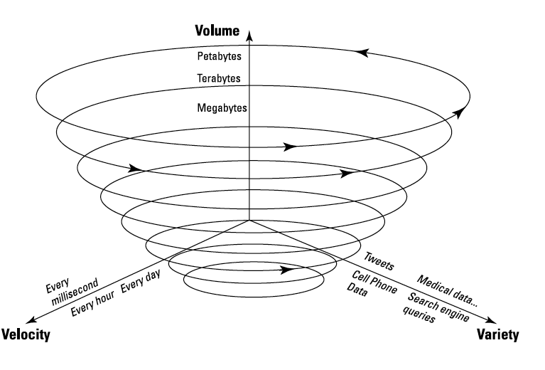

Slide 120
Complexities in Searching Your Data
The two main concepts of searching your data in preparation for using it in predictive analytics:
Getting ready to go beyond the basic keyword search
Making your data semantically searchable

Slide 121
Keyword-based search
Searching large amounts of data.
One way to approach the problem is to issue a search query that consists of words.
Assume following search query:
“the President of the United States visits Africa. The search results will consist of text that contains exactly one or a combination of the words President, United States, visits, Africa. ”
How about the documents that do not contain any of the words previously mentioned, but some combination of the following: Obama’s trip to Kenya.
None of the words you initially searched for are in there — but the search results are semantically (meaningfully) useful.
Notes:
1.The search tool looks for matching words in the database, the data warehouse, or goes rummaging through any text in which your data resides.
You might get the exact information you’re looking for, but not always.

Slide 122
Semantic-based search
The vice president of the Human Development Network outlined one problem that sprang from ambiguity:
His division used several terms and concepts that had the same overall meaning but different nuances.
For instance, terms such as climatology, climate change, gas ozone depletion, and greenhouse emissions were all semantically related but not identical in meaning.
He wanted a search capability smart enough to extract documents that contained related concepts when someone searched any of these terms.
The prototype’ framework for that capability selected was the Unstructured Information Management Architecture (UIMA), a software-based solution.
Originally designed by IBM Research, UIMA is available in IBM software such as IBM Content Analytics, one of the tools that powered IBM Watson, the famous computer that won the Jeopardy game.

Slide 123
Semantic-based search
Semantic search is based on the contextual meaning of search terms as they appear in the searchable data space that UIMA builds.
Semantic search is more accurate than the usual keyword-based search
Because a user query returns search results of not only documents that contain the search terms, but also of documents that are semantically relevant to the query.
Through semantic tagging and use of ontologies, information becomes semantically retrievable, independent of the language or the medium in which the information was created (Word, PowerPoint, e-mail, video, and so on).
This solution provides a single hub where data can be captured, organized, exchanged, and rendered semantically retrievable

Slide 124
Differentiating Business Intelligence from Big-Data Analytics
Business intelligence (BI) is about building a model that answers specific business questions.
You start with a question or a set of questions, gather data and data sources, and then build a computer program that uses those resources to provide answers to the business questions you’ve targeted.
Business intelligence is about providing the infrastructure for searching your data and building reports.
Business intelligence uses controlled data — predefined, structured data, stored mainly in data-warehousing environments.
BI uses online analytical processing (OLAP) techniques to provide some analytical capabilities —
enough to construct dashboards you can use to query data, as well as create and view reports, to answer predefined questions.
BI does not provide data mining or new insights.

Slide 125
Differentiating Business Intelligence from Big-Data Analytics
Big-data analytics is a more generalized data-exploration task:
You don’t necessarily know exactly what you’re looking for, but you’re open to all discoveries.
Analytics can dive into the collected and prepared data
to unveil insights that could have gone undiscovered otherwise.
Analytics rely on newer technologies that allow deeper knowledge discovery in large bodies of data of any type (structured, unstructured, or semi-structured);
Technologies designed for such work include Hadoop and MapReduce.

Slide 126
Predictive modeling and BI
Predictive Analytics emerged to complement, rather than compete with, business intelligence.
You can co-ordinate your pursuit of analytics with business intelligence:
by using BI to pre-process the data you’re preparing for use in your predictive analytics model.
You can point BI systems to different data sources
Visualizations that BI produces from raw data — to give you an overview of your data even before you start designing your analytics model.
This approach leads to the visualization of large amounts of raw data.

Slide 127
Visualization of Raw Data
A picture is worth a thousand words — especially when you’re trying to get a good handle on your data.
At the pre-processing step, while you’re preparing your data, it’s a common practice to visualize what you have in hand before continuing to the next step.
You start by using a spreadsheet such as Microsoft Excel to create a data matrix — which consists of candidate data features (also referred to as attributes).
Several business intelligence software packages (such as Tableau) can give you a preliminary overview of the data to which you’re about to apply analytics.

Slide 128
Identifying data attributes
In programming terms, data is a collection of objects and their corresponding attributes.
A data object is also called a record, item, observation, instance, or entity.
A data object can be described by a collection of attributes that describe it.
A data attribute is also known as feature, field, or characteristic.
Attributes can be nominal, ordinal, or interval:
Nominal attributes are numbers (for example, zip codes) or nouns (for example, gender).
Ordinal attributes, in most cases, represent ratings or rankings (for example, degree of interest in buying Product A, ranked from 1 to 10 to represent least interest to most interest).
Interval attributes represent data range, such as calendar dates.

Slide 129




What is an attribute
A property or characteristics of an object that may vary either from one object to another or from one time to another.
Ex. Eye color may vary person to person
Temperature of an object varies over time
To analyze more precisely the characteristics of object we need a measuring scale
Measurement scale: A rule (function) that associates a numerical or symbolic values with an attribute of an object

Slide 130
Attribute Types
Categorical
Nominal
Binary
ordinal
E.g., major, CS major, academic ranks
Numeric: discrete or continuous
Interval-scale or ratio-scaled (true zero)
E.g., year 2000, number of users, annual income

Slide 131
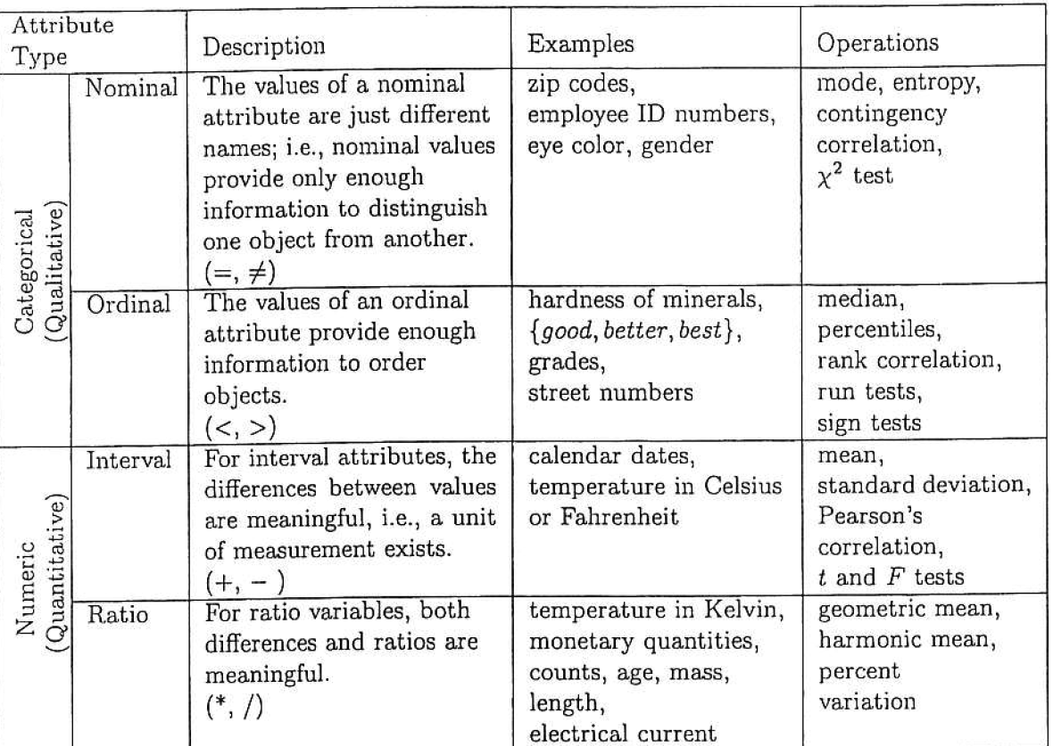
Different types of Attribute

Slide 132
TRANSFROMATION IN ATTRIBUTES
Permissible transformations
For example, the meaning of a length attribute is unchanged if it is measured in meters instead of feet.
The statistical operations that make sense for a particular type of attribute are those that will yield the same results when the attribute is transformed by using a transformation that preserves the attribute’s meaning.
To illustrate, the average length of a set of objects is different when measured in meters rather than in feet, but both averages represent the same length.

Slide 133
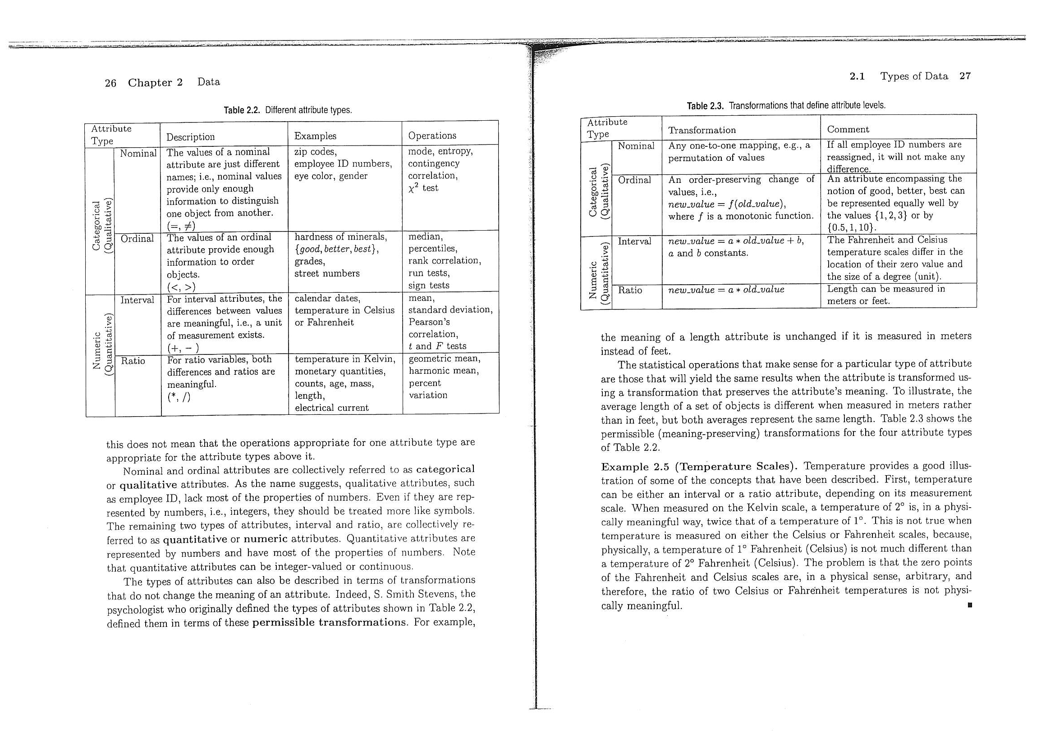
Attributes : in terms of transformation

Slide 134
Exploring data visualization
Tabular visualizations
Bar charts
Pie charts
Graph charts
Word clouds as representations
Line graphs
Flocking birds representation

Slide 135
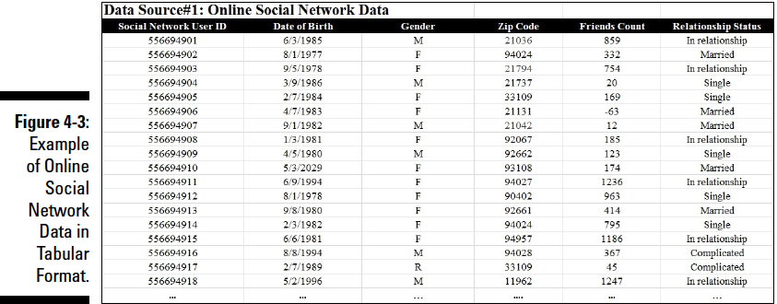
Tabular visualizations
Tables are the simplest, most basic pictorial representation of data.
Tables (also known as spreadsheets) consist of rows and columns — which correspond, respectively, to the objects and their attributes mentioned earlier as making up your data

Slide 136
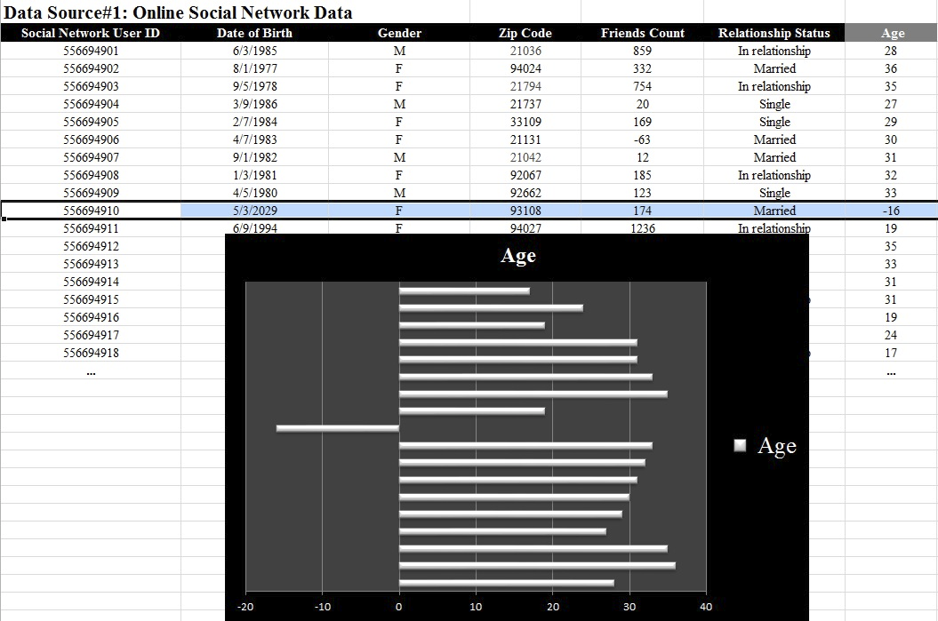
Bar charts
Used to spot spikes or anomalies in your data
Bar charts can be also used to start a discussion of how to normalize your data.
Normalization is the adjustment of some — or all — attribute values on a scale that makes the data more usable

Slide 137
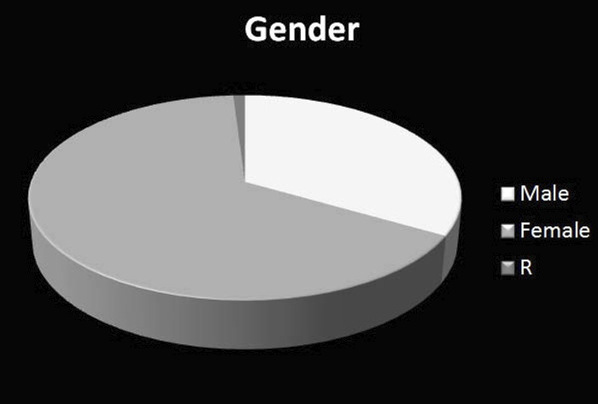
Pie charts
Pie charts are used mainly to show percentages.
They can easily illustrate the distribution of several items, and highlight the most dominant

Slide 138
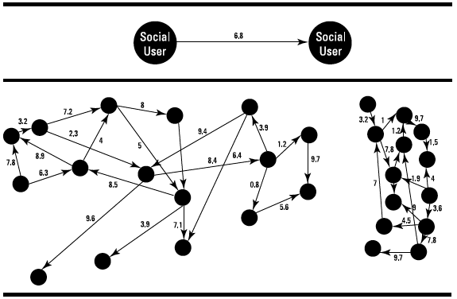
Graph charts
Graph theory provides a set of powerful algorithms that can analyze data structured and represented as a graph.
In computer science, a graph is data structure, a way to organize data that represents relations between pairs of data objects.
A graph consists of two main parts:
Vertices, also known as nodes
Edges, which connect pairs of nodes
Edges can be directed (drawn as arrows) and can have weights

Slide 139
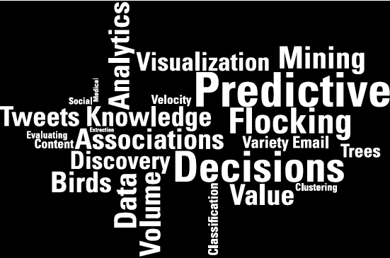
Word clouds as representations
Consider a list of words or concepts arranged as a word cloud — a graphic representation of all words on the list, showing the size of each word as proportional to a metric that you specify.
For instance, if you have a spreadsheet of words and occurrences and you’d like to identify the most important words, try a word cloud.

Slide 140
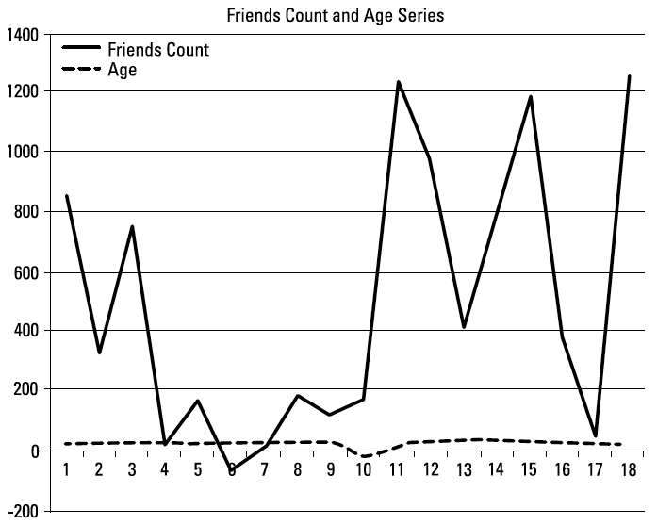
Line graphs
Line graphs — a traditional way of representing data — enable you to visualize
multiple series or multiple attributes (columns) in the same graph.

Slide 141
Flocking birds representation
“Birds of a feather flock together” is a traditional saying that provides instant
insight as a way of visualizing data: Individuals of similar tastes, interests,
dreams, goals, habits, and behaviors tend to congregate in groups.
Natural flocking behavior in general is a self-organizing system in which objects (in particular, living things) tend to behave according to
the environment they belong to
their responses to other existing objects.
The flocking behavior of natural societies such as those of bees, flies, birds, fish, and ants — or, for that matter, people — is also known as swarm intelligence.

Slide 142
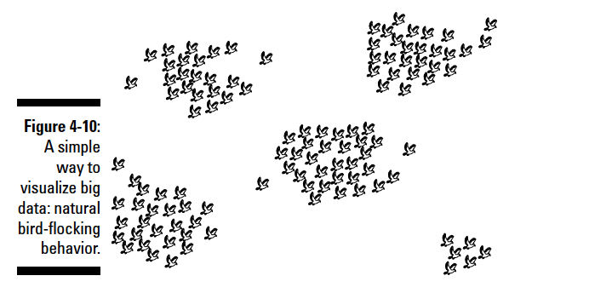
Flocking birds representation
Flock-mates are birds located with a certain distance from each other; those birds are considered similar.
Each bird moves according to the three main rules that organize flocking behavior.
Separation: Flock-mates must not collide with each other.
Alignment: Flock-mates to move in the same average direction as their neighbors.
Cohesion: Flock-mates move according to the average position or location of their flock-mates.
Notes:
Modeling those three rules can enable an analytical system to simulate flocking
behaviors. That’s because biologically inspired algorithms, in particular
those derived from bird-flocking behavior, offer a simple way to model social
network data. Using the self-organized natural behavior of flocking birds,
you can convert a straightforward spreadsheet into a visualization such
as Figure 4-10.
The key is to define the notion of similarity as part of your
data — and construct a mathematical function that supports that similarity.
Start with a couple of questions:
✓ What makes two data objects in your data similar?
✓ Which attributes can best drive the similarity between two data records?
For instance, in social network data, the data records represent individual
users; the attributes that describe them can include Age, Zip Code, Relationship
Status, List of Friends, Number of Friends, Habits, Events Attended, Books Read,
and other groups of particular interests (Sports, Movies, and so on).
You can define the similarity for your group according to nearly any attribute.
For example, you can call two members of a social network similar if they read
the same books, have a large number of common friends, and have attended
the same events. Those two similar members will flock together if they’re
represented by birds flocking in a virtual space.

